Slide 1
Color Models

Slide 2
What is Color
- Color is a powerful descriptor that often simplifies object identification and extraction from a scene.
- Color is a fundamental attribute of our viewing experience

Slide 3
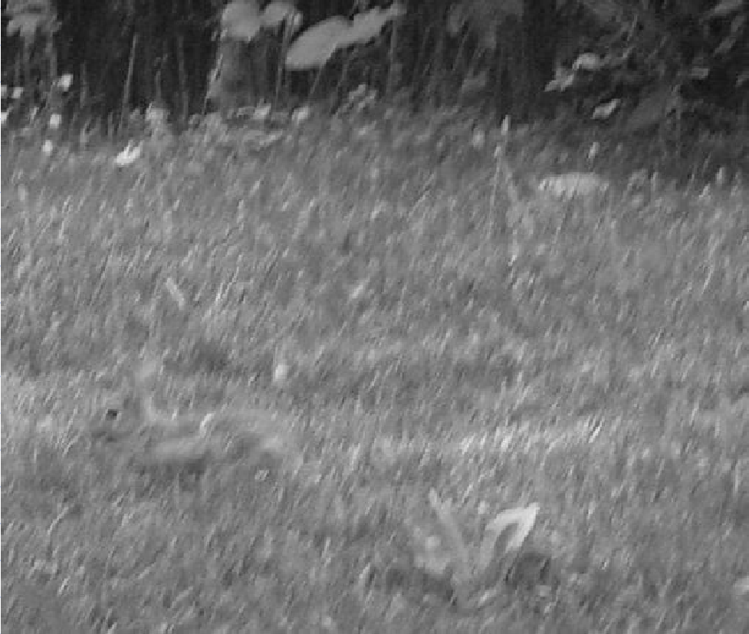
Preview

Slide 4
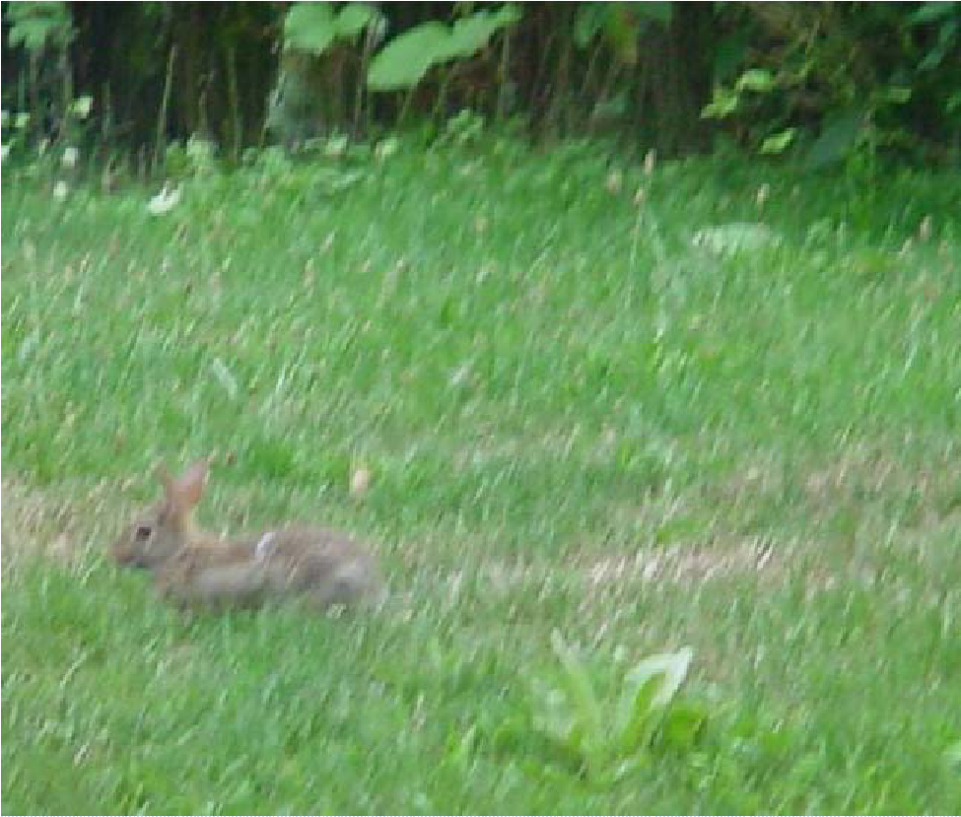
Preview

Slide 5
Light
Light is fundamental for color vision
Unless there is a source of light, there is nothing to see!
What do we see?
We do not see objects, but the light that has been
reflected by or transmitted through the objects

Slide 6
Types of Color Model
RGB model
Color monitor, color video cameras
CMY model
Color printer
HSI model
Color image manipulation
XYZ (CIE standard, Y directly measures the luminance)
YUV (used in PAL color TV)
YIQ (used in NTSC color TV)
YCbCr (used in digital color TV standard BT.601)

Slide 7
Color Models
The purpose of a color model (also called color space or color system) is to facilitate the specification of colors in some standard, generally accepted way.
RGB (red, green, blue) : monitor, video camera.
CMY(cyan, magenta, yellow),CMYK (CMY, black) model for color printing.
and HSI model, which corresponds closely with the way humans describe and interpret color.

Slide 8
RGB (red, green, blue)
The RGB colour space is related to human vision through the tristimulus theory of colour vision.
The RGB is an additive colour model. The primary colours red, green and blue are combined to reproduce other colours.
In the RGB colour space, a colour is represented by a triplet (r,g,b)
r gives the intensity of the red component
g gives the intensity of the green component
b gives the intensity of the blue component
Here we assume that r,g,b are real numbers in the interval [0,1].
You will often see the values of r,g,b as integers in the interval [0,255].

Slide 9
RGB Color model
Active displays, such as computer monitors and television sets, emit combinations of red, green and blue light. This is an additive color model
9

Slide 10
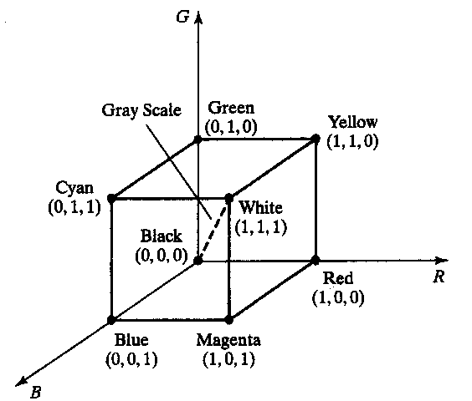
The RGB Color Spaces

Slide 11

CMY Color model
Source: www.hp.com
Passive displays, such as color inkjet printers, absorb light instead of emitting it. Combinations of cyan, magenta and yellow inks are used. This is a subtractive color model.
11

Slide 12
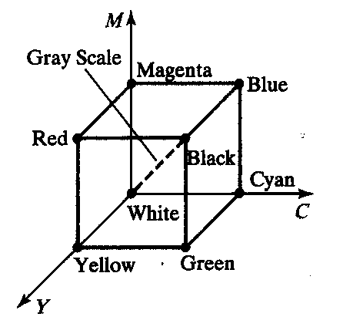
The CMY and CMYK Color Spaces

Slide 13
The CMY and CMYK Color Models
Cyan, Magenta and Yellow are the secondary colors of light
Most devices that deposit colored pigments on paper, such as color printers and copiers, require CMY data input.

Slide 14
The conversion from RGB to CMY is given by the formula
Example : The red colour is written in RGB as (1,0,0). In CMY it is written as
that is, magenta and yellow.

Slide 15
Example : The magenta is written in CMY as (0,1,0). In RGB it is
written as
giving,
that is, red and blue.

Slide 16
CMYK model
For printing and graphics art industry, CMY is not enough; a fourth primary, K which stands for black, is added.
Conversions between RGB and CMYK are possible, although they require some extra processing.

Slide 17



HSI Color Model
H
dominant
wavelength
S
purity
% white
I
Intensity
Source: http://www.cs.cornell.edu/courses/cs631/1999sp/
17

Slide 18
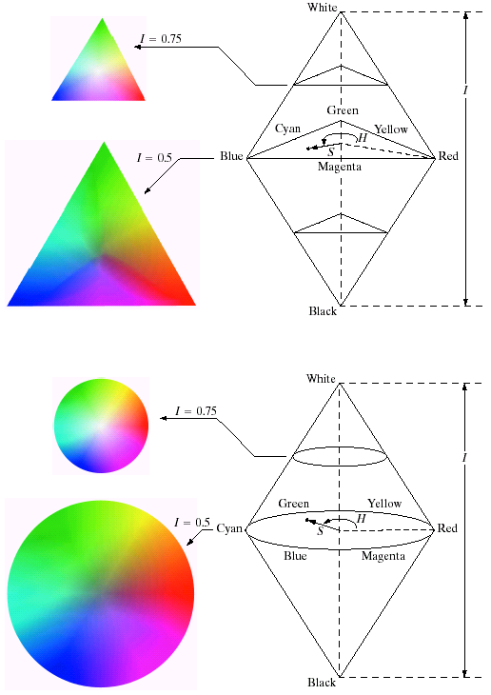
HSI Color Model

Slide 19
HSI Color Model
Hue is defined as an angle
0 degrees is RED
120 degrees is GREEN
240 degrees is BLUE
Saturation is defined as the percentage of distance from the center of the HSI triangle to the pyramid surface.
Values range from 0 to 1.
Intensity is denoted as the distance “up” the axis from black.
Values range from 0 to 1
19

Slide 20
HSV
The components of the HSV colour space are Hue, Saturation and Value.
Colour is the result of the perception of light at different wavelengths. Usually, we do not experience light at a single wavelength but a blend of waves at different wavelengths. The hue corresponds to the dominant wavelength and determines the type of the colour, for example red, yellow, or blue.
The saturation determines the purity of the colour. High saturation gives pure colours (narrow wavelength band), while low saturation means colours mixed with a lot of white (white light combines all the visible wavelengths).
The value determines the brightness. A value equal to zero represents absence of light, while a high value gives bright colours.

Slide 21
The HSI Color Models
Converting colors from RGB to HSI

Slide 22
The HSI Color Models
Converting colors from HSI to RGB
RG sector :

Slide 23
The HSI Color Models
Converting colors from HIS to RGB
GB sector :

Slide 24
The HSI Color Models
Converting colors from HIS to RGB
BR sector :

